Slide 1
Instance Based Learning Srinivas Battula VIT-AP University

Slide 2
K-Nearest Neighbors
WIN 2020-21

Slide 3
Today’s plan
Instance Based Learning
K-Nearest Neighbor (kNN)
Distance metric
Pros/Cons of nearest neighbor
Validation, cross-validation, hyperparameter tuning

Slide 4
Instance Based Learning
Instance-based learning is often termed lazy learning, as there is typically no “transformation” of training instances into more general “statements”
Instead, the presented training data is simply stored and, when a new query instance is encountered, a set of similar, related instances is retrieved from memory and used to classify the new query instance.
Hence, instance-based learners never form an explicit general hypothesis regarding the target function. They simply compute the classification of each new query instance as needed.

Slide 5
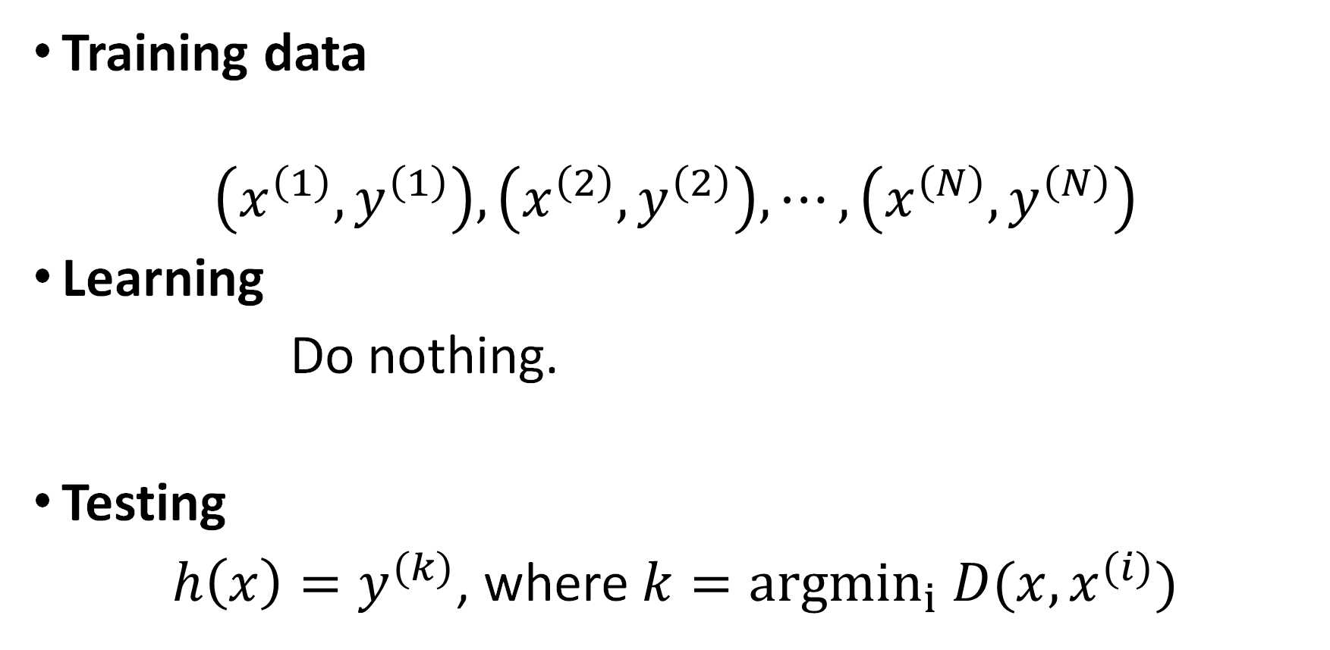
Nearest neighbor classifier
Training data
$$\left(x^{\left(1\right)},y^{\left(1\right)}\right), \left(x^{\left(2\right)},y^{\left(2\right)}\right), ⋯,\left(x^{\left(N\right)},y^{\left(N\right)}\right)$$
Learning
Do nothing.
Testing
$h\left(x\right)=y^{(k)}$, where $k={argmin}_{i} D(x, x^{(i)})$

Slide 6
k-NN Approach
The simplest, most used instance-based learning algorithm is the k-NN algorithm
k-NN assumes that all instances are points in some n-dimensional space and defines neighbors in terms of distance (usually Euclidean in R-space)
k is the number of neighbors considered

Slide 7
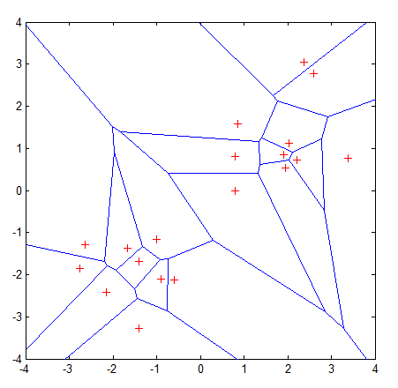
Graphic Depiction
Properties:
All possible points within a sample's Voronoi cell are the nearest neighboring points for that sample
For any sample, the nearest sample is determined by the closest Voronoi cell edge

Slide 8
k-NEAREST NEIGHBOR A set of positive and negative training examples is shown on the left, along with a query instance x_{q}, to be classified. The I-NEAREST NEIGHBOR algorithm classifies x_{q}, positive, whereas 5-NEAREST NEIGHBOR classifies it as negative. On the right is the decision surface induced by the 1-NEAREST NEIGHBOR algorithm for a typical set of training examples. The convex polygon surrounding each training example indicates the region of instance space closest to that point

Slide 9
Basic Idea
Using the second property, the k-NN classification rule is to assign to a test sample the majority category label of its k nearest training samples
In practice, k is usually chosen to be odd, so as to avoid ties
The k = 1 rule is generally called the nearest-neighbor classification rule

Slide 10
k-NN Algorithm
For each training instance t=(x, f(x))
Add t to the set Tr_instances
Given a query instance q to be classified
Let x₁, …, x_{k} be the k training instances in Tr_instances nearest to q
Return
Where V is the finite set of target class values, and δ(a,b)=1 if a=b, and 0 otherwise (Kronecker function)
Intuitively, the k-NN algorithm assigns to each new query instance the majority class among its k nearest neighbors

Slide 11
Simple Illustration
q is + under 1-NN, but – under 5-NN

Slide 13
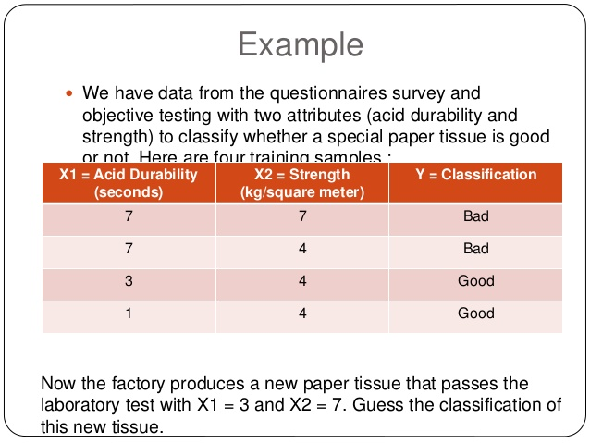

Slide 14
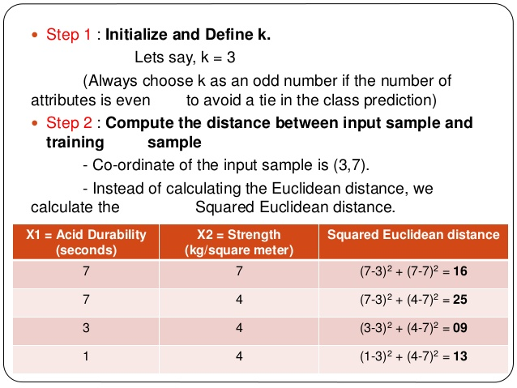

Slide 15
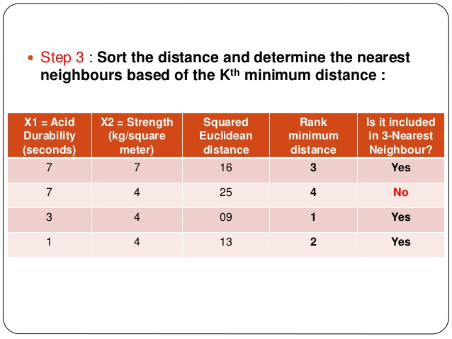

Slide 16
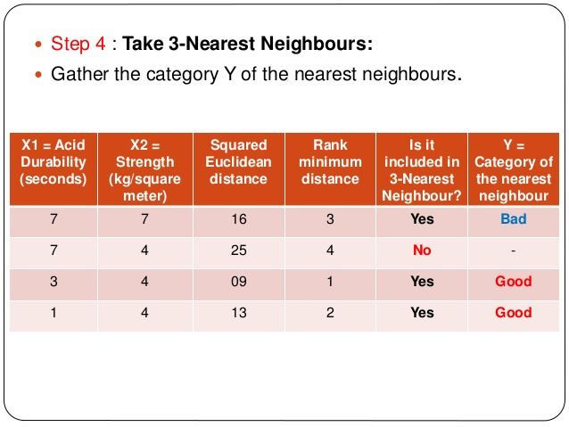

Slide 17
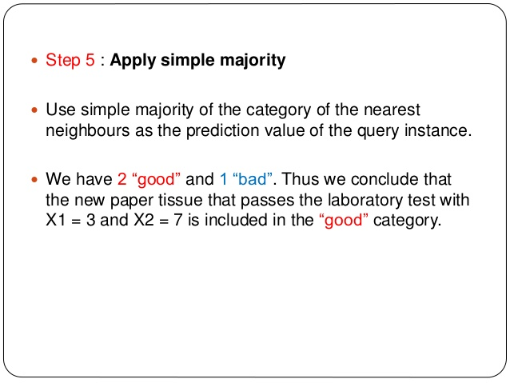

Slide 18
Scale Effects
Different features may have different measurement scales
E.g., patient weight in kg (range [50,200]) vs. blood protein values in ng/dL (range [-3,3])
Consequences
Patient weight will have a much greater influence on the distance between samples
May bias the performance of the classifier

Slide 19
Standardization
Transform raw feature values into z-scores
is the value for the i^{th} sample and j^{th} feature
is the average of all for feature j
is the standard deviation of all over all input samples
Range and scale of z-scores should be similar (providing distributions of raw feature values are alike)

Slide 20
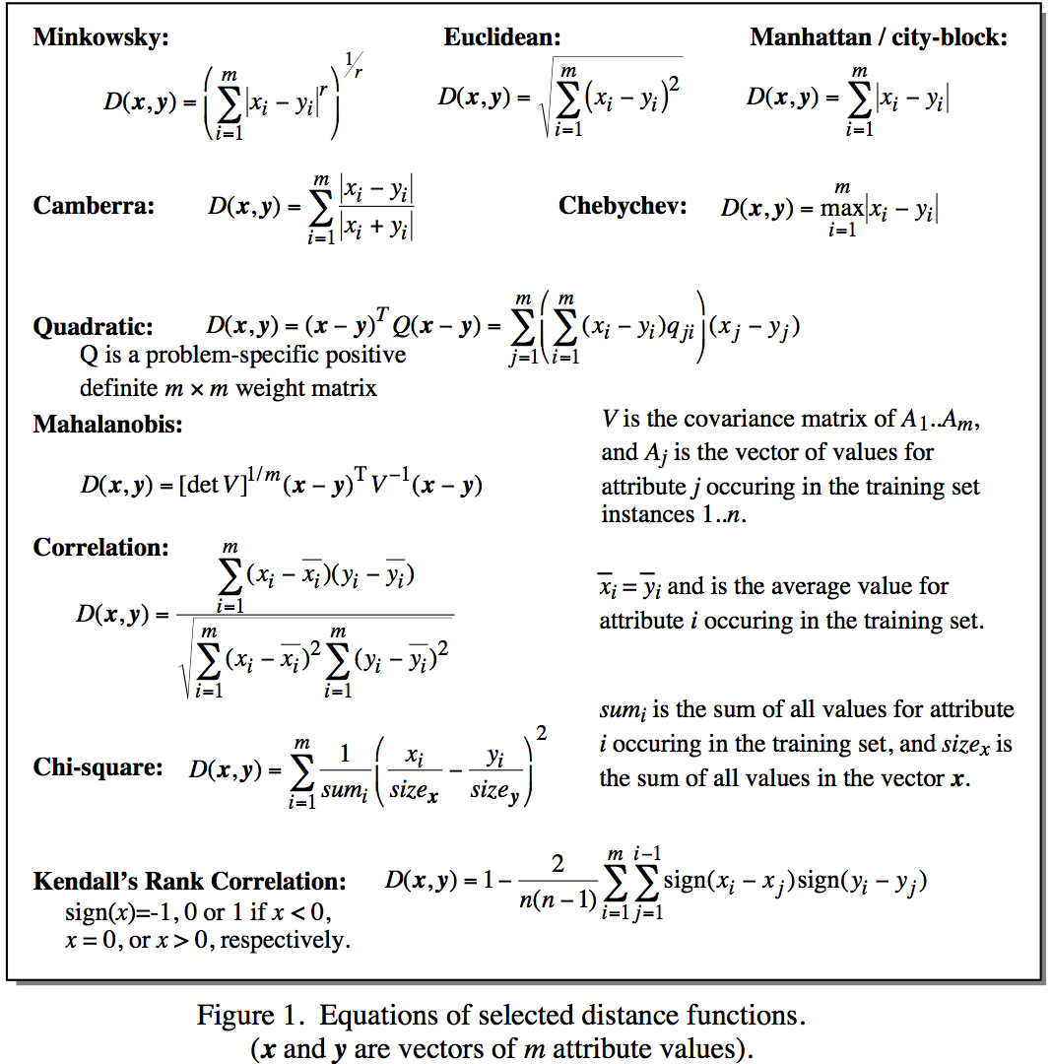
Distance Metrics
Notes:
Minkowsky = l-norm

Slide 21
Some Remarks
k-NN works well on many practical problems and is fairly noise tolerant (depending on the value of k)
k-NN is subject to the curse of dimensionality (i.e., presence of many irrelevant attributes)
k-NN needs adequate distance measure
k-NN relies on efficient indexing

Slide 22
How is kNN Incremental?
All training instances are stored
Model consists of the set of training instances
Adding a new training instance only affects the computation of neighbors, which is done at execution time (i.e., lazily)
Note that the storing of training instances is a violation of the strict definition of incremental learning.

Slide 23
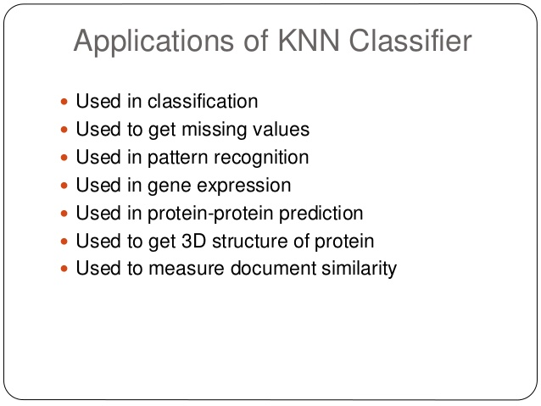
Applications

Slide 24
Distance-weighted k-NN
Replace by:

Slide 25
Some Remarks
k-NN works well on many practical problems and is fairly noise tolerant (depending on the value of k)
k-NN is subject to the curse of dimensionality (i.e., presence of many irrelevant attributes)
k-NN needs adequate distance measure

Slide 26
How is kNN Incremental?
All training instances are stored
Model consists of the set of training instances
Adding a new training instance only affects the computation of neighbors, which is done at execution time (i.e., lazily)
Note that the storing of training instances is a violation of the strict definition of incremental learning.

Slide 27
Predicting Continuous Values
Replace by:
Note: unweighted corresponds to w_{i}=1 for all i

